Slide 1
Toward a Natural
Lake Mendota:
Our Gift to Future Generations
Capital Region Advocacy Network for Environmental Sustainability
CRANES
Lake Mendota Level Recommendations v.2012.03.28
DRAFT

Slide 2
The current draft of this presentation was prepared with the help of many folks.
Additional feedback is encouraged. Please send to:
Jon Becker
CRANES Board Vice-President & Treasurer 2010-12
JonBecker@AOL.com
The inclusion of information from various experts does not imply their support for the CRANES recommendations.

Slide 3
Madison’s Lakes Were Once Prized for Their Beauty and Clarity
“Not a ripple was to be seen on the surface of the lake. It lay gleaming in the sun like a vast resplendent mirror.... I felt as if I was under the influence of some invisible alien power impressing me that this was to be my lifelong home, and thus it has been.” ~ Darwin Clarke, June 1837
But it was not just picturesque beauty of the lakes that people noticed; it was the clarity of their water.
[You can] “see the drifts of white sand far down to the transparent depths [of Lake Monona].” ~ Massachusetts reporter, 1853
Such descriptions routinely appeared in early writings about Madison. It is difficult to exaggerate the importance [many] civic leaders placed on the beauty of the lakes and the clarity of their waters. They were widely viewed as the soul of the city, a reminder that Madison was special and had a high destiny.
Adapted from:
“Our city, our lakes” ~
David Mollenhoff, 19 July 2007
(re-printed in Isthmus Annual Manual 2010-11)

Slide 4
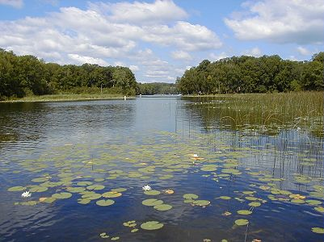
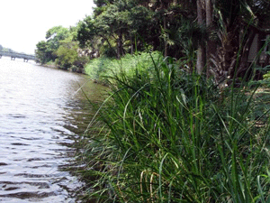
How Natural Lakes Look

Slide 5
Toward a Natural Lake Mendota
PHASE 1: STOPPING THE DAMAGE
No later than MAR 2013, lower the 1979 Lake Order summer targets by 6”. Adjust the winter 2013-14 target to equal the new summer minimum target.
PHASE 2: RESTORATION FOR A MORE NATURAL LAKE
By JAN 2014, complete all studies and public participation necessary to begin further lowering the summer targets 2” per year, starting in summer 2014, until the natural level is achieved (~58” total). Annually adjust the Winter target to match the preceding summer’s minimum target.
CONCURRENT LAND USE MANAGEMENT
Require that all future development in the Lake Mendota sub-watershed recreates natural hydrological conditions, while also retrofitting existing development insofar as possible toward this standard, to assure that Lake Mendota is not utilized as a detention facility for unnatural stormwater runoff.

Slide 6
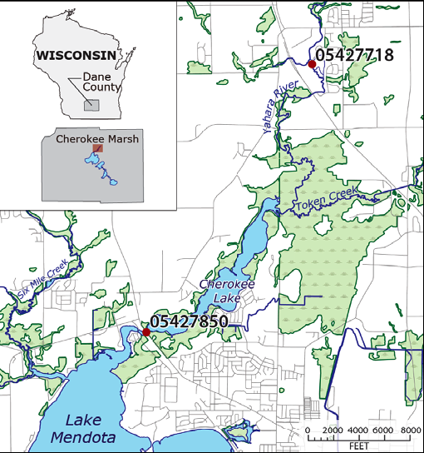
ORIENTATION
The upper
Yahara River, north
Lake Mendota and
Cherokee Marsh, present day
• = gage station

Slide 7
Toward a
Natural Lake Mendota
PHASE 1: STOPPING THE DAMAGE
Lower Lake Mendota by 6 inches

Slide 8
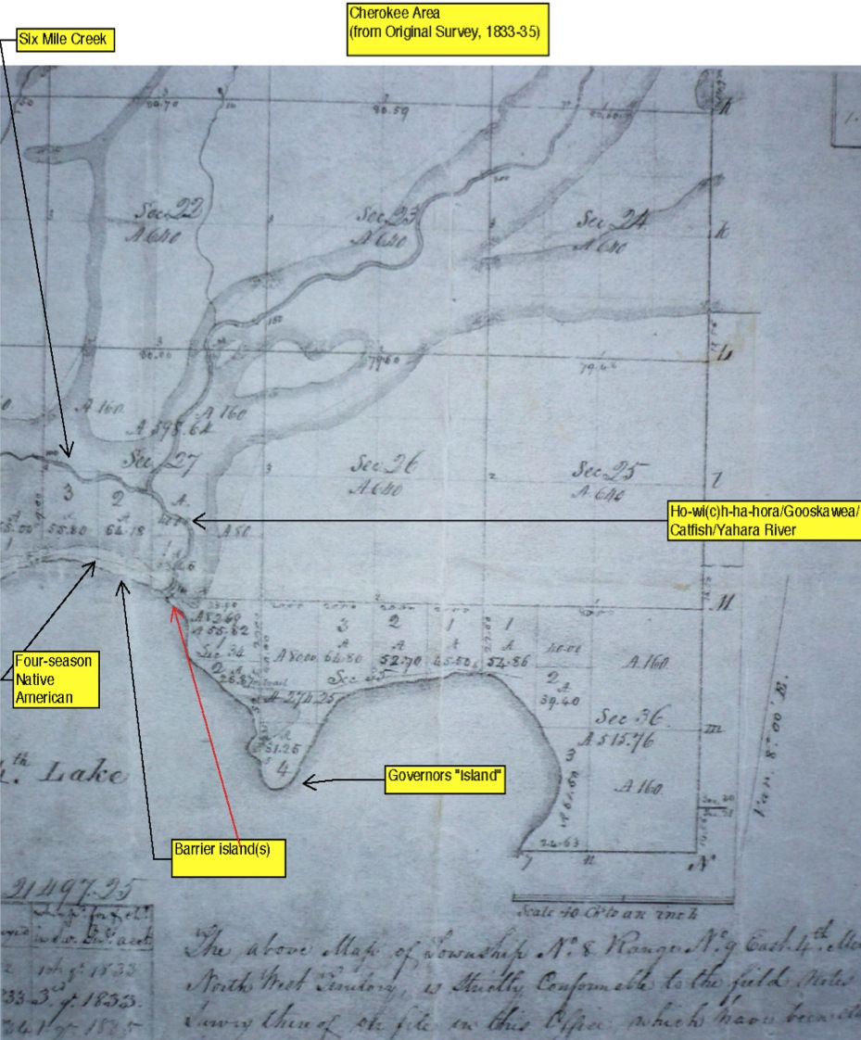
Original Survey Map
(1833-35)
Six Mile Creek meets a much narrower
Yahara River* inside a large marsh.
A four-season
Native American trail traversed barrier islands or a land-bridge across the Yahara estuary.
* The Yahara River was formerly named:
Ho-wi(c)h-ha-hora
Gooskawe
Catfish

Slide 9
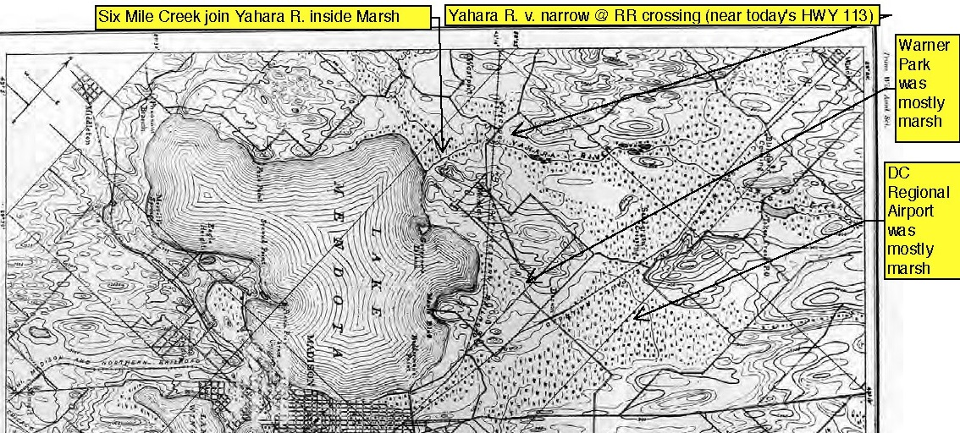
An 1893 map of flora:
Today’s isthmus, Warner Park and DC Regional Airport environs were mostly wetlands and marshes, flourishing with diverse biota.
Cheney, L.S. and R.H. True. 1893. On the flora of Madison and vicinity, a preliminary paper on the flora of Dane County, Wisconsin. Trans. Wis. Acad. Sci., Arts and Lett. 9:45-135. ~ Courtesy R. Lathrop, UW, who surmises that the depiction of Lake Mendota’s northern shore likely was based on maps from the 1830s survey.

Slide 10
In the 1840s, it was proposed that a dam be built on the Yahara River’s outlet at the south end of Lake Mendota, to power a mill.
Construction of the dam was resisted by many residents.
Some lakeshore property owners threatened a “takings” lawsuit, because private lands would be drowned when the lake level rose.
However, powerful dam proponents, including Gov. Farwell, were able to get State of WI legislation passed that pre-empted property rights.
The lake and its admirers lost the battle.

Slide 11
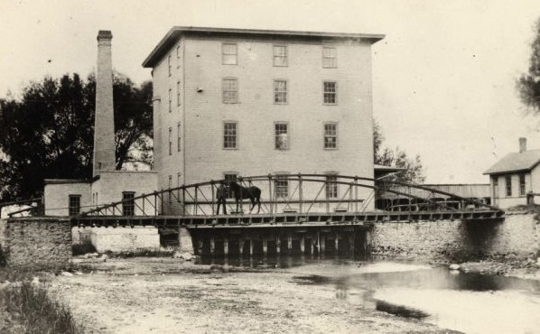
In 1849, Farwell Dam was built, near the Yahara River’s outlet, in the area that is now Tenney Park.
The 4-story Madison Mills was owned by Gov. Farwell.
PHOTO CREDIT: 1890, from WI State Historical Society archives

Slide 12
Because of the governor’s mill,
Lake Mendota suddenly in 1849, became a
VERY LARGE,
UNNATURAL,
MILLPOND.
(in addition to being used
as a sewage facility and garbage dump,
like all the other Yahara lakes).

Slide 13
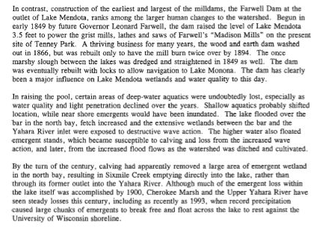
The mill that was created by Farwell Dam created a head that powered then
Wisconsin Governor Leonard Farwell’s “Mendota Mills.”
Lake Mendota Priority Watershed Groundwater and Wetlands Report (WDNR, 2000)

Slide 14
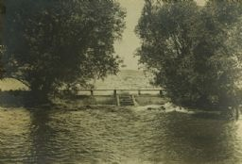
Early spillway at Tenney Park (date unknown)
Photo: Wisconsin Historical Society

Slide 15
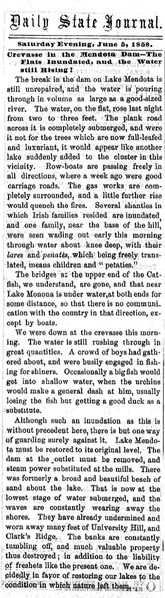
A 5 June 1858 break in the dam elicited a summary of damage done by the unnaturally high levels, including the loss of several bridges.
Those included erosion of land on the banks of the lake, and the loss of a former “broad and beautiful beach of sand about the lake.”
The writer editorialized:
“Lake Mendota must be restored to its former level. …
We are decidedly in favor of restoring our lakes to the condition in which nature left them.”
Clipping: Wisconsin Historical Society

Slide 16
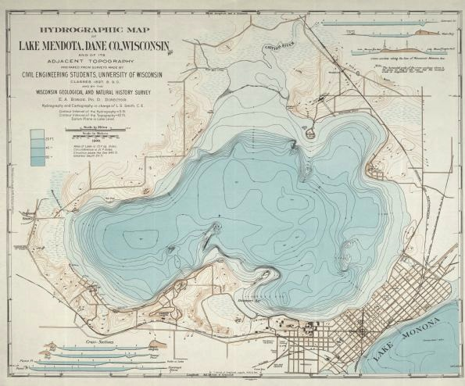
By the early 1860s, when a young John Muir paddled north to Cherokee Marsh from the UW campus, the Yahara estuary’s marsh, barrier islands, and Native American trail had all been drowned.
(as illustrated on this 1900 hydrological map)
submerged former shoreline

Slide 17
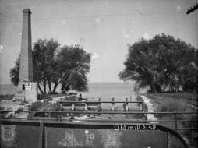
By 1894, the dam had washed out on a few occasions and
Farwell Mill had burned twice.
This 1895 photo is identified as “the Old Mill Site.”
Photo: WI Historical Society

Slide 18
Yahara Waterways Water Trail Guide
“Additional dams placed at Tenney Park over the past 150 years kept water levels high, as do today’s locks that facilitate recreational boat traffic. Today’s lake level is a minimum of 5.5 feet above what nature intended, and might be as much as seven to eight feet higher according to a 1900 hydrographic map produced by the Wisconsin Geological and Natural History Survey.”
Publisher: Dane County Environmental Council (2007)

Slide 19
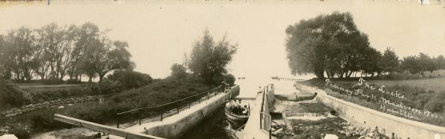
Boaters in Tenney Park Locks, 1906
Photo: Wisconsin Historical Society

Slide 20
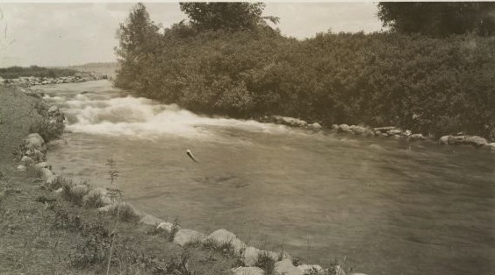
The Mill Race at Tenney Park, 1910
Photo: Wisconsin Historical Society

Slide 21
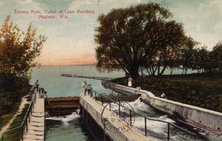
Locks and spillway at Tenney Park, 1909
Postcard: Wisconsin Historical Society

Slide 22
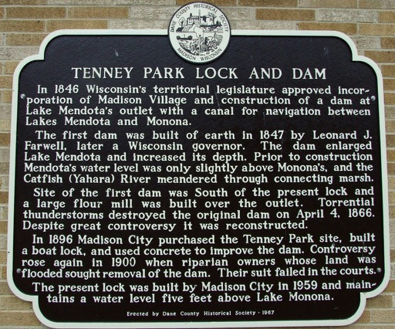
In the 20th century, the dam was again raised, despite flooding and renewed civic opposition.
The current lock was built in 1959 and “maintains a water level five feet above Lake Mendota” according to this Dane County Historical Society plaque, 1967)

Slide 23
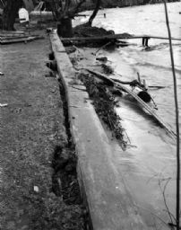
Ever since the first dam was built in 1849, high water has caused damage to lake shore properties and civic infrastructure.
It still does today.
High Water Damage, 1653 Sherman Ave, 27 APR 1950
Photo: Wisconsin Historical Society

Slide 24
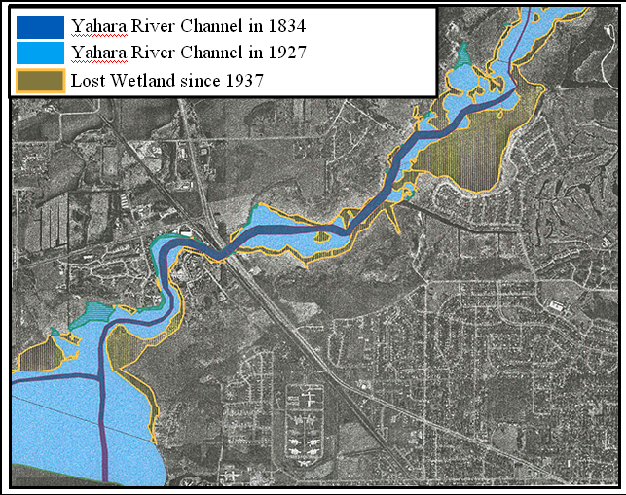
Unnaturally high lake levels, as well as dredging of what is now called “Cherokee Lake,” have contributed to marsh loss indicated by the light blue and brown areas of this map, about a square mile of high quality marsh.
The destruction continues to this day, on our watch.
1937
MAP CREDIT: Russ Hefty, City of Madison Parks

Slide 25
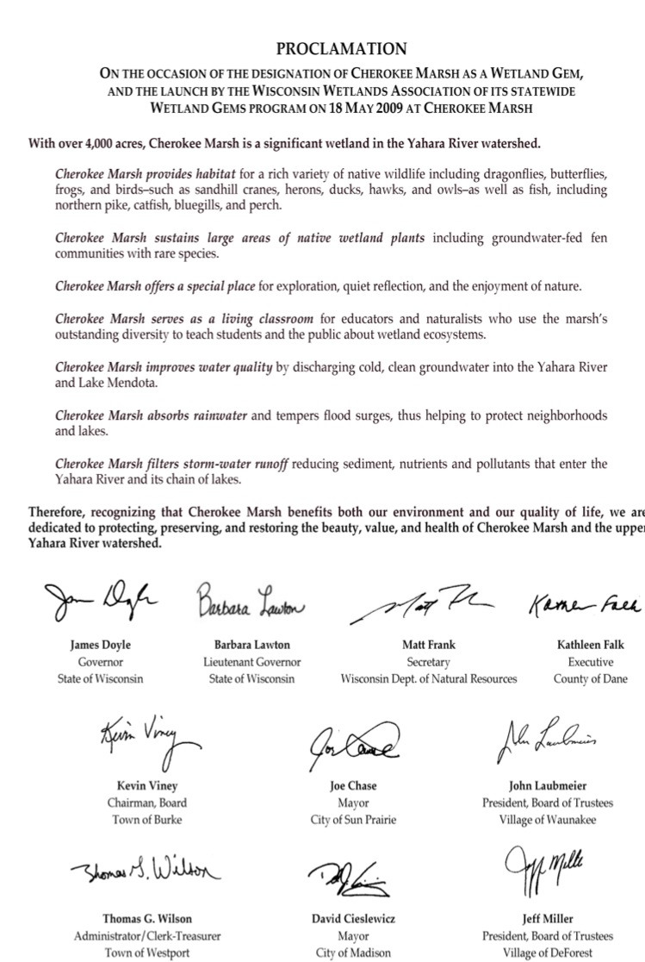
This costly devastation persists despite broad support, for protecting our remaining wetlands and the uplands that make them resilient and ecologically sustainable.
…from Dane County citizens, and elected local, county and state officials.
AT RIGHT:
18 May 2009 Proclamation on the occasion of the designation of
Cherokee Marsh environs as a Wisconsin Wetlands Gem.
One of 100 such areas statewide so designated by the WI Wetlands Assn.

Slide 26
Now, protection of only that which has survived is no longer enough.
Those who would defend the status quo must consider how the many poor decision and compromises of the past now limit our options going forward.
Additionally, climate change related precipitation trends are making the destructive forces faster and bigger.
Restoration of more wetlands is necessary, to replace valuable ecosystem infrastructure.

Slide 27
The WDNR 1979 Lake Orders are also harming Lake Mendota’s ecology and water quality.
Lake Mendota’s target levels under the Orders
have regularly been exceeded since the 1970s.
Why?
Inherent outcome of the Orders’ downstream requirements?
Bigger boats and larger/more marinas on Lakes Mendota and Monona?
Precipitation changes related to climate change?

Slide 28
During the1920s, 30s and 40s, Lake Mendota was generally managed near what would have been the low end of the 1979 Lake Orders, had those been in effect.
Chart: R Lathrop, MAR 2012

Slide 29
This management pattern mostly continued during the1950s, 60s, and early 70s.
Chart: R Lathrop, MAR 2012

Slide 30
Since the later 1970s, Lake Mendota has often been managed above the 1979 Lake Orders targets during summers and, since 2000, with a generally lower Winter level.
Chart: R Lathrop, MAR 2012

Slide 31
“[The chart] shows the difference between the monthly minimum and maximum water levels for each year since 1920.
Coincident with higher water maximum summer levels and much lower winter levels since the early 2000s, the annual fluctuation in water levels has increased quite a bit in recent years compared to prior decades.
In some years [Lake] Mendota did show characteristics of being a reservoir.”
Graph and comments: R. Lathrop, 5 MAR 2012

Slide 32
“… it is pretty obvious that [Lake Mendota] summer levels in general have trended upward over the entire period of record with levels in the early decades being near or below the current summer operating range. From the 1940s through the early 1970s, summer levels were generally within the current operating guidelines.
Since the early 1990s, many summers had months with levels above the summer operating range and not one summer below the range except for late summer 1988 at the end of a severe 2-year drought when water levels were within an inch of the operating level. Water levels during more recent droughts have all been well into the summer operating range.
Since 1920 there have been some changes in winter water levels in Mendota, too. Winter levels were relatively low (compared to the current summer operating guidelines) in the 1920s-30s. In general from the 1940s through the early 1970s winter water levels in general were not much lower than the current summer level guideline. However, since the mid-1970s winter levels declined again. Since about 2001, the winter drawdown has been more pronounced as evidenced by the orange and red monthly colors.”
R. Lathrop, 5 MAR 2012

Slide 33
Lake Monona would also be better protected from surface flooding when Lake Mendota is lowered 6 inches, based on an analysis of data from 1980 to the present.
There would be increased storage capacity for storing precipitation from the flashier, more intense climate change related events of the past two decades.
The lake level problems associated with a severe drought would be rare and manageable.

Slide 34
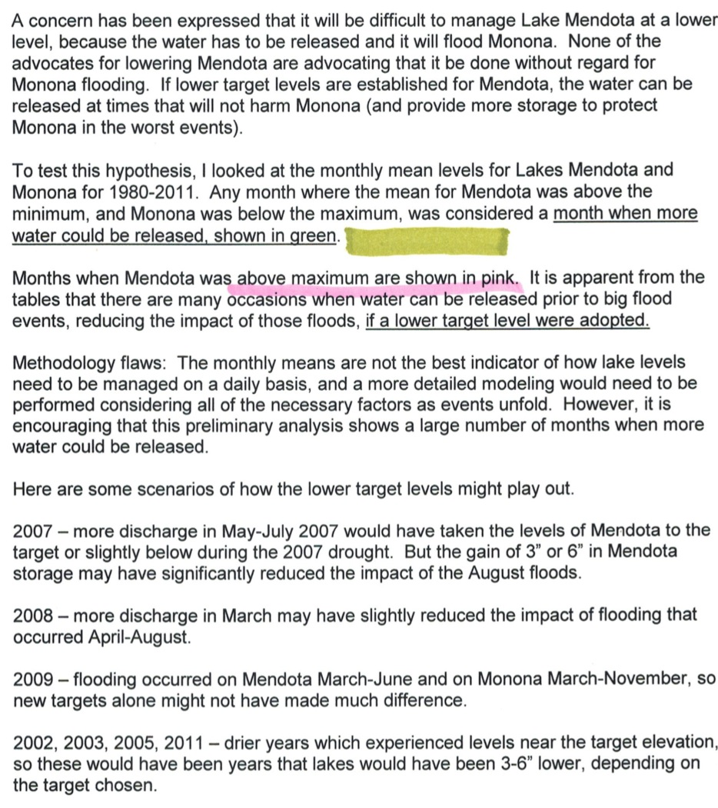
“It is apparent from the [following four] tables that there are many occasions when water can be released
[from Lake Mendota] prior to big flood events, reducing the impact of those floods, if a lower target level was to be adopted.”
Commentary and, on next two slides, chart analyses:
S. Widstrand, DRAFT 3 MAR 2012

Slide 35
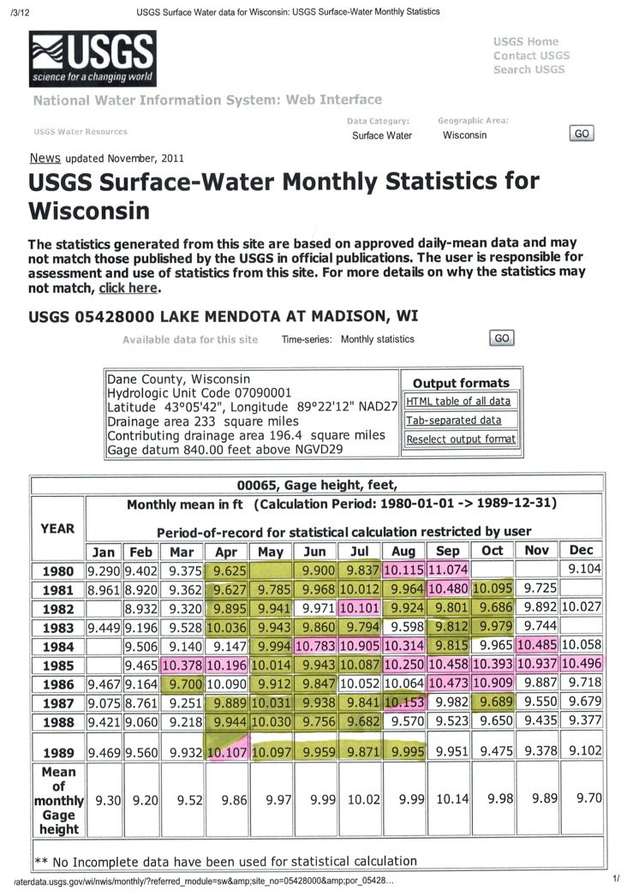
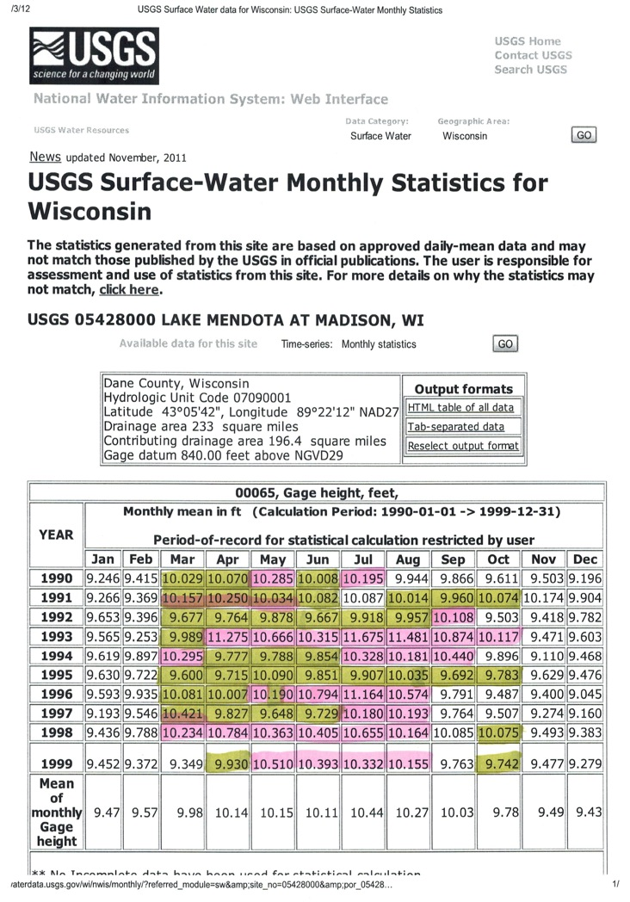
Chart analysis:
S. Widstrand, DRAFT 3 MAR 2012

Slide 36
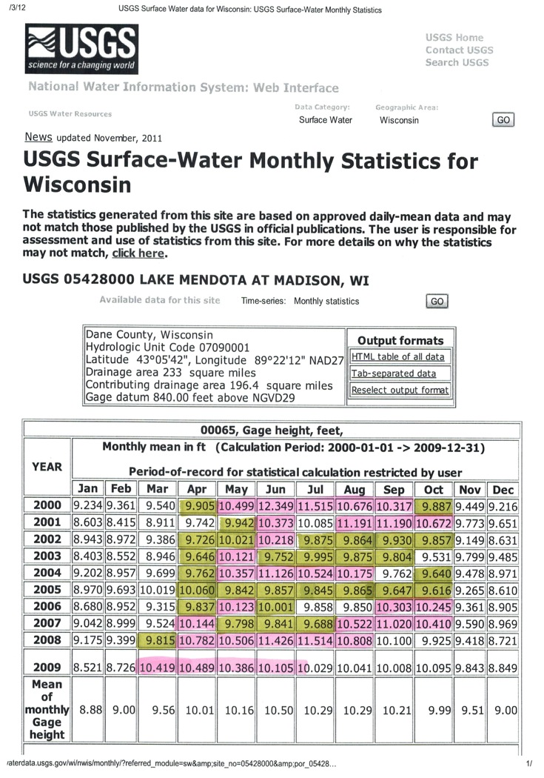
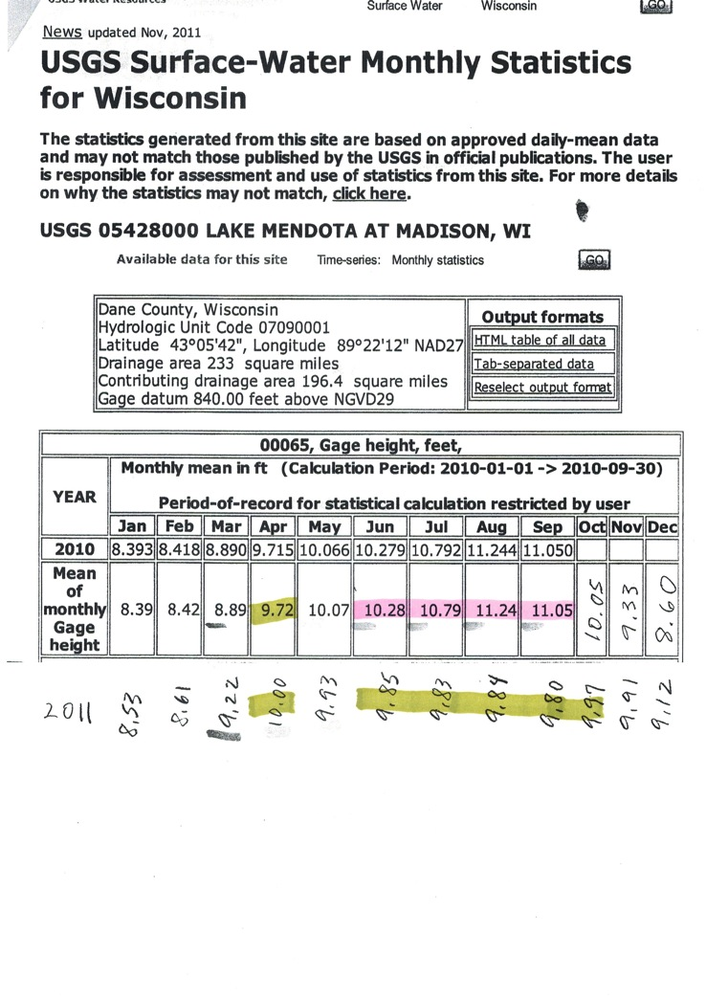
Chart analysis:
S. Widstrand, DRAFT 3 MAR 2012

Slide 37
“It appears that the average [L Mendota] summer water level has been raised 0.65 feet and shifted the balance from
[6% above max and
60% below max] to
[33% above max and
7.5% below max].”
Data analysis and comments: S. Widstrand; 10 JAN 2012

Slide 38
1979 WDNR Lake Orders have resulted in a Lake Mendota that is too often even higher than the already unnaturally high levels previously allowed by the dam and lock at Tenney Park.

Slide 39
2010s?

Slide 40
What would a Lake Mendota look like March through October if it were 6 inches lower than the Summer minimum target of the
WDNR 1979 Lake Orders?
Much like it does in the following photos.
Taken on 17 December 2011,
when Lake Mendota was at an elevation of 849.12,
or about 6" below the current Summer minimum.

Slide 41
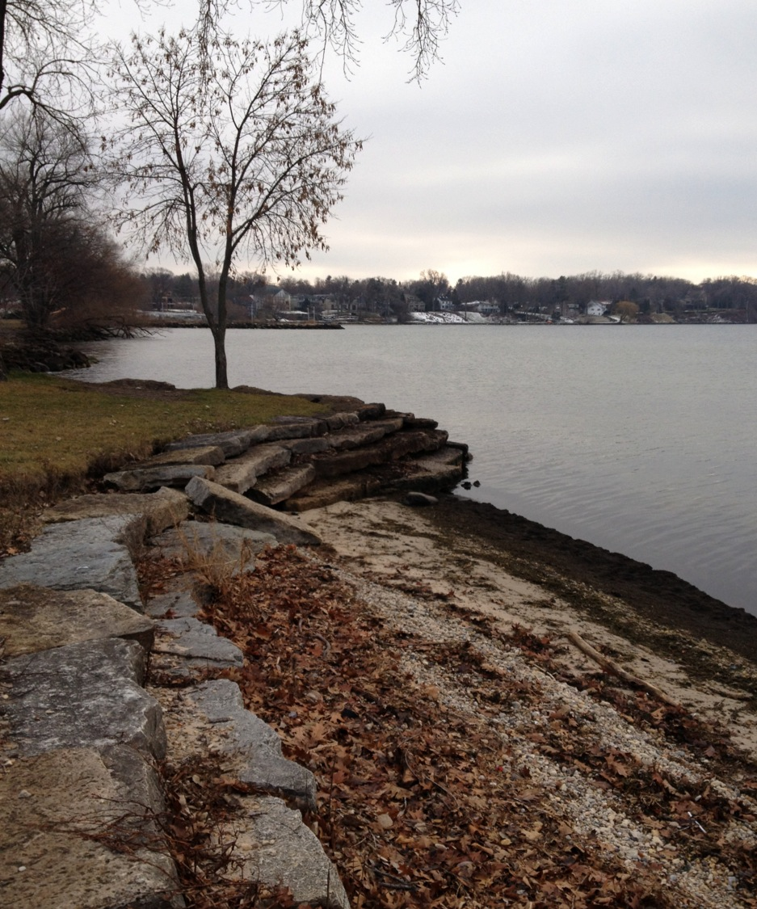
Warner Park shoreline structure, view south
PHOTO: Jon Becker

Slide 42
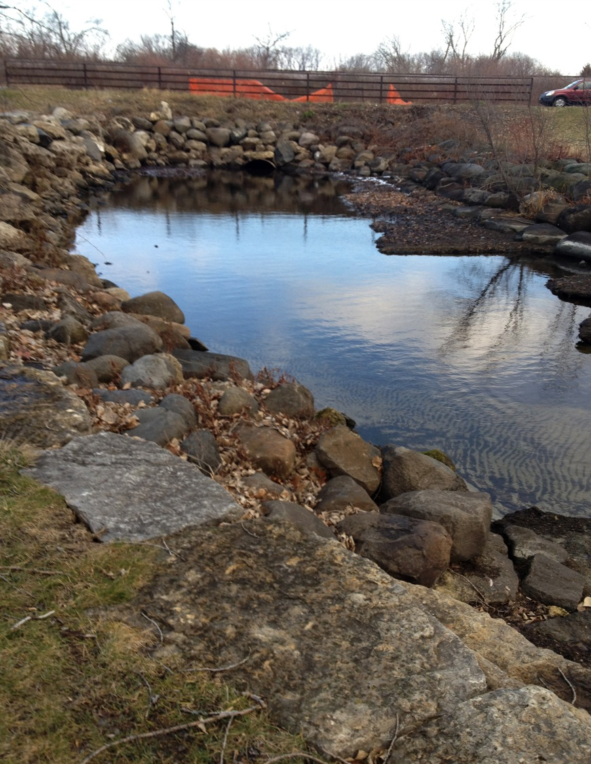
Warner Park lagoon outlet, view east
PHOTO: Jon Becker

Slide 43
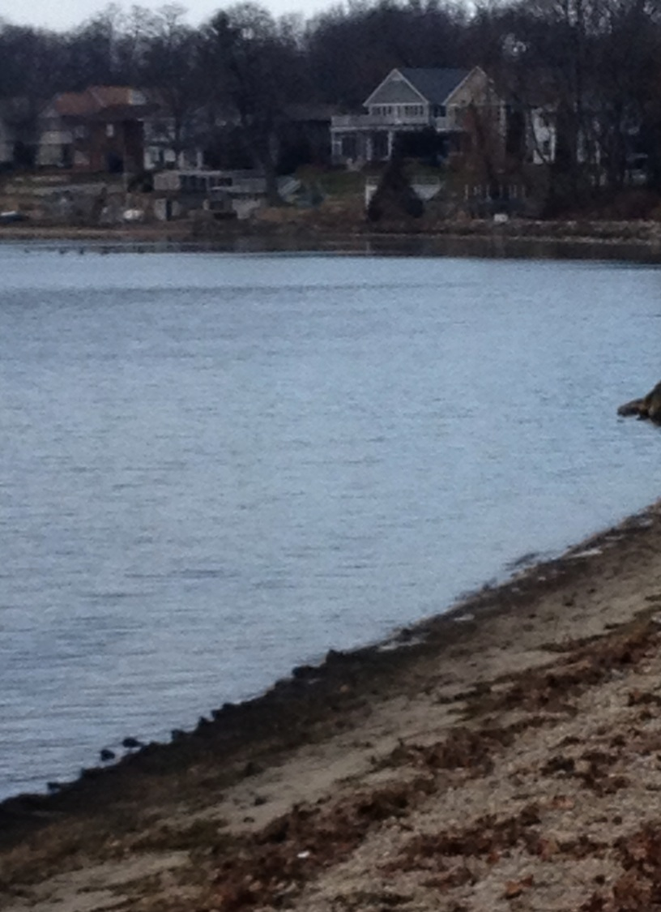
Warner Park neighboring residential shoreline, view north
PHOTO: Jon Becker

Slide 44
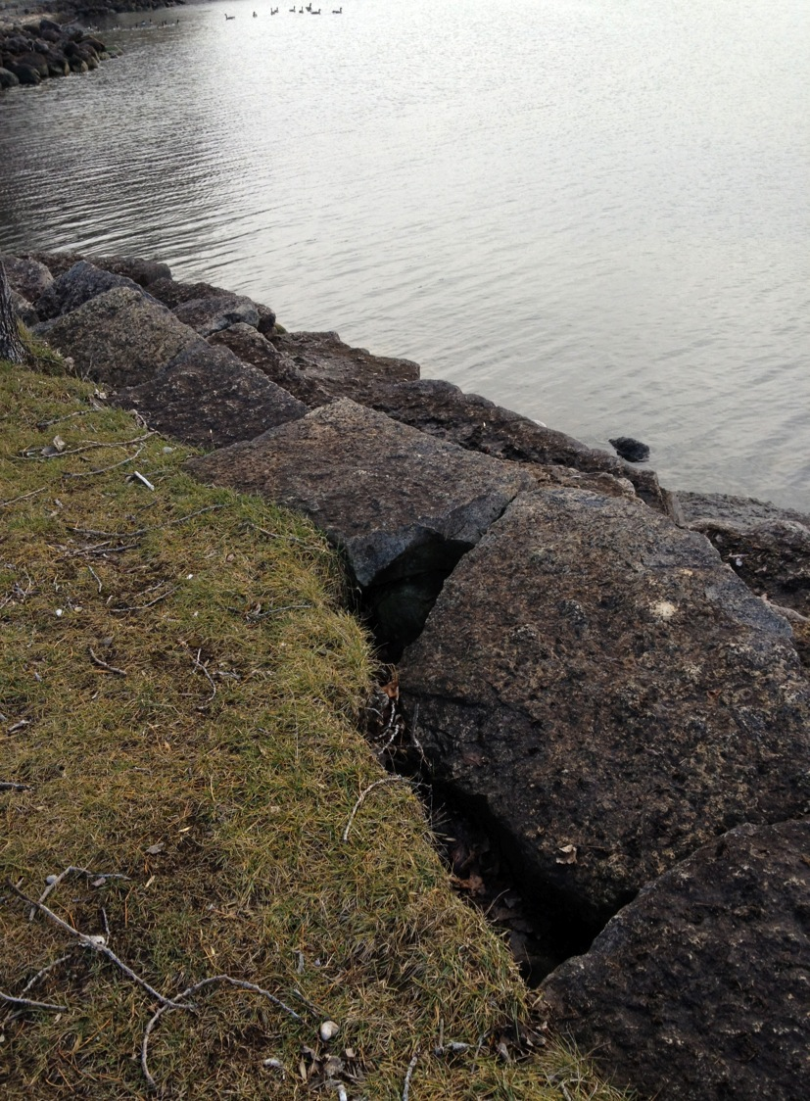
Warner Park, shoreline erosion from wave/wind action at high water levels, stormwater runoff, grass sod vs. native plants, etc.
PHOTO: Jon Becker

Slide 45
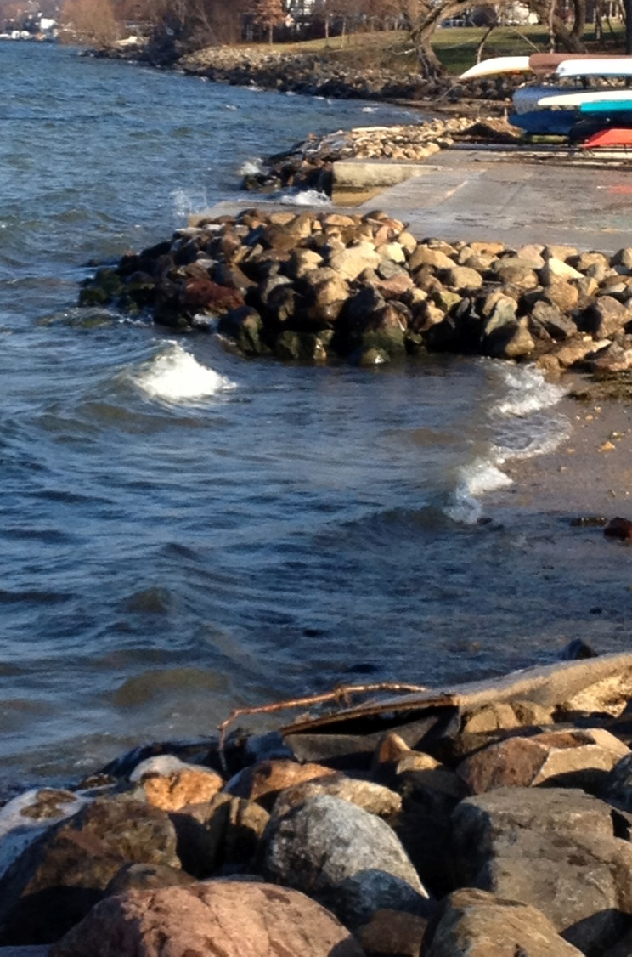
James Madison Park, view northeast
PHOTO: Jon Becker

Slide 46
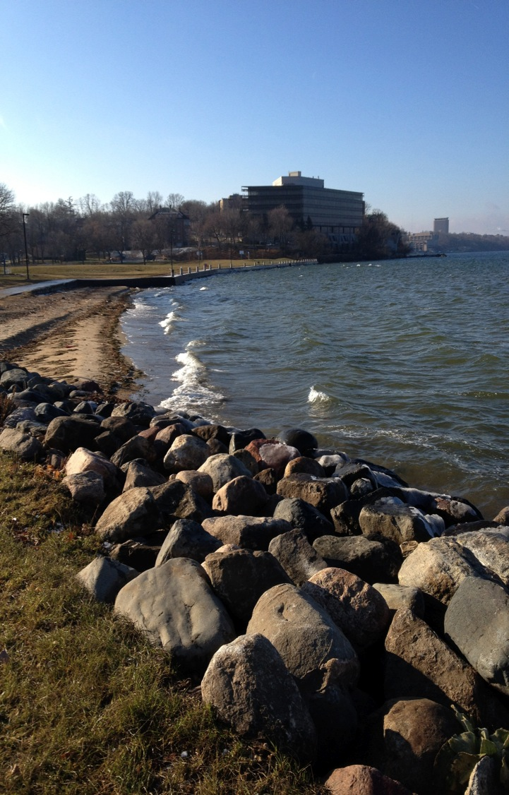
James Madison Park, view southwest
PHOTO: Jon Becker

Slide 47
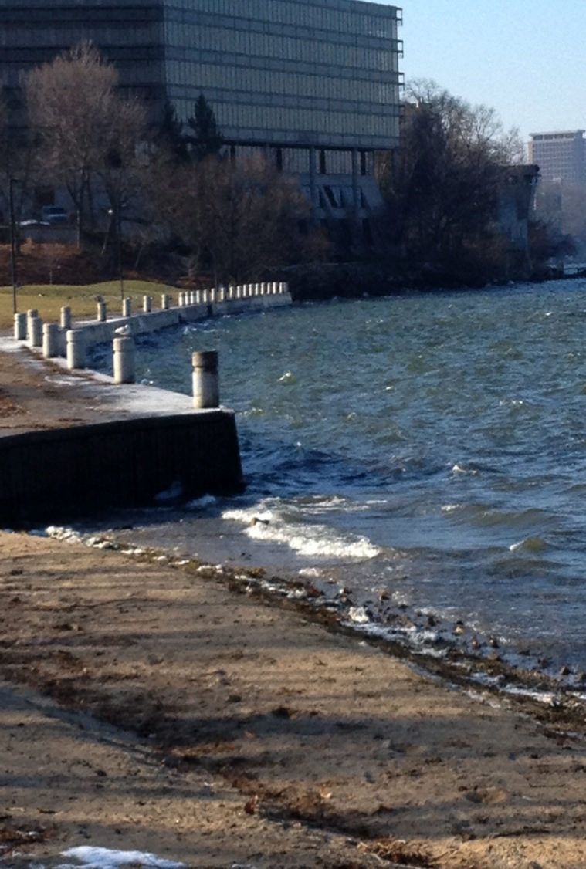
James Madison Park, view southwest
PHOTO: Jon Becker

Slide 48
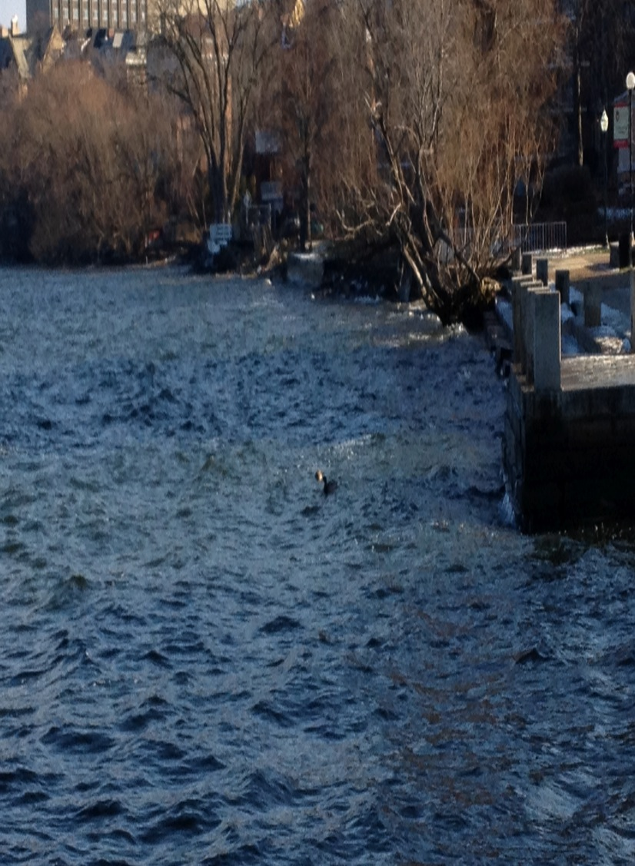
UW Union Terrace, view northeast
PHOTO: Jon Becker

Slide 49
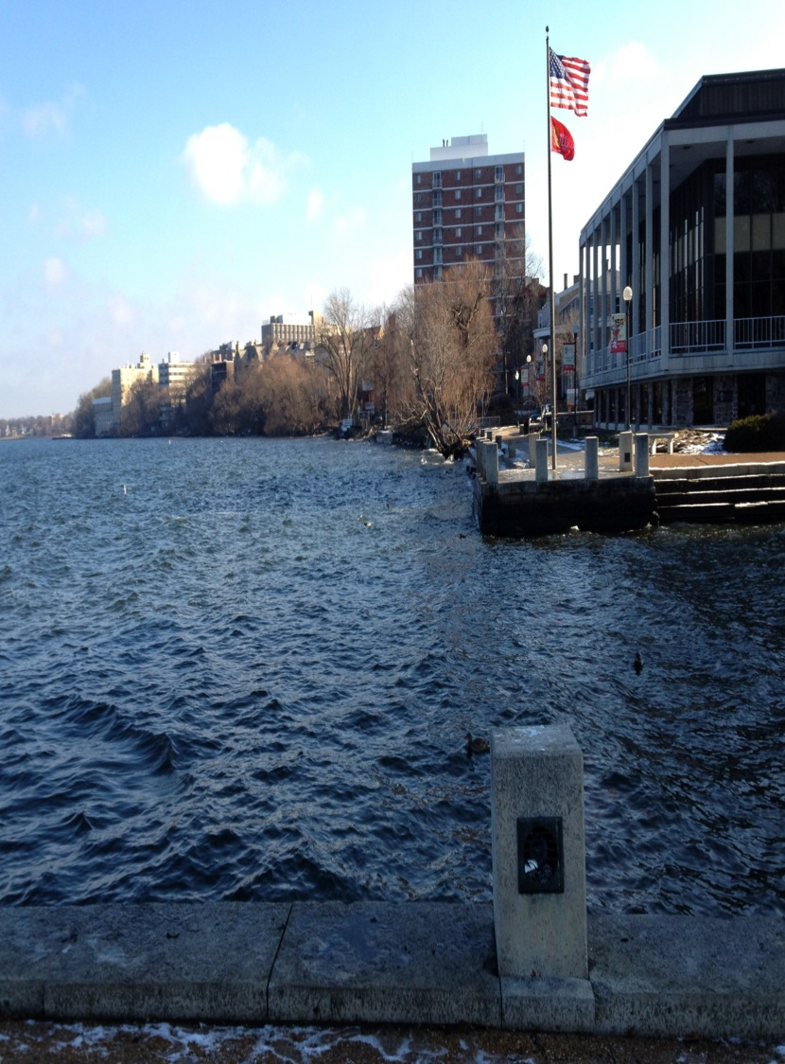
UW Union Terrace, view northeast
(note: access via waterfront steps to lake is maintained)
PHOTO: Jon Becker

Slide 50
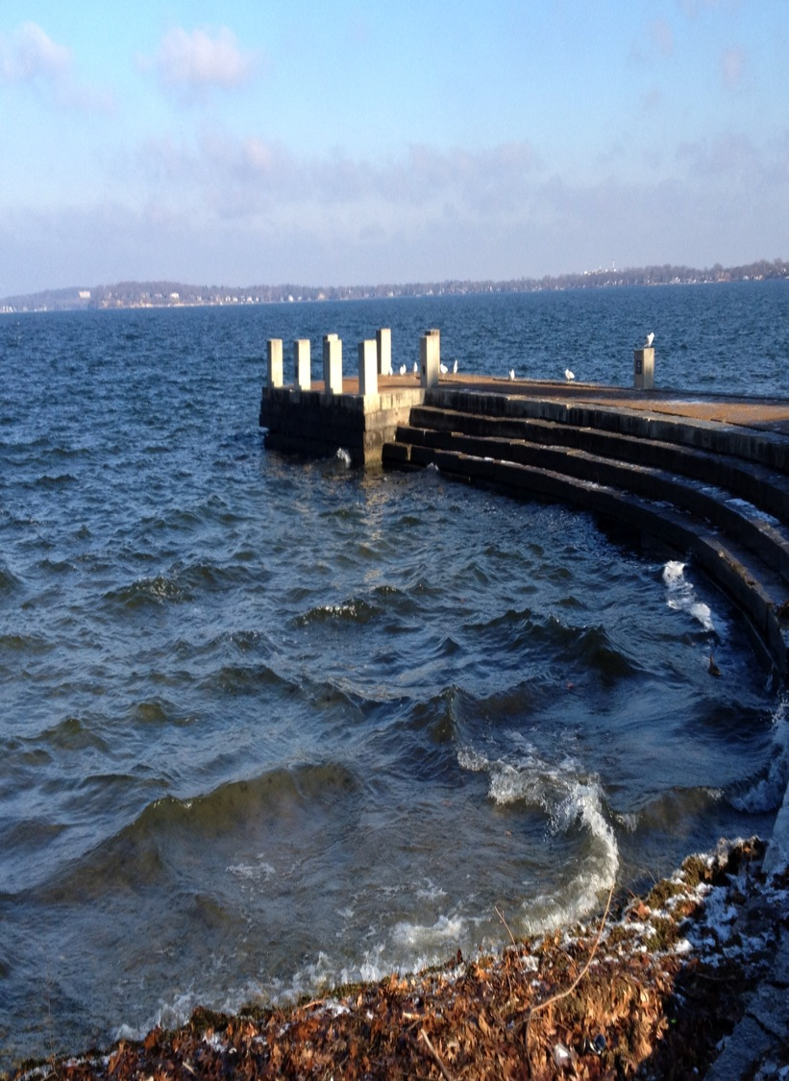
UW Union Terrace, view northeast
(note: plenty of pier access)
PHOTO: Jon Becker

Slide 51
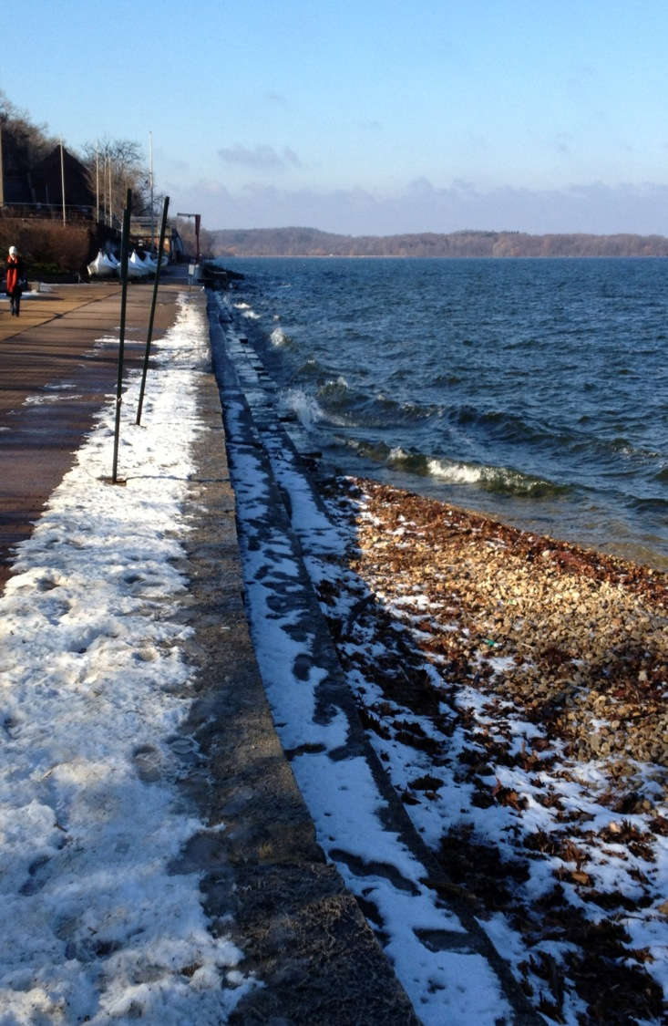
UW Union Terrace, view southwest
PHOTO: Jon Becker

Slide 52
In other words…
… the world will not end
if Lake Mendota summer target levels
are lowered 6 inches.
(and it actually gets that low 10% of the time)

Slide 53
Winter Target Reduction
Q. Why adjust the
winter 2013-14 target to equal
the new summer minimum target?
A: To reduce damage to
habitat and shorelines
from conditions resulting from the
WDNR 1979 Lake Orders.

Slide 54
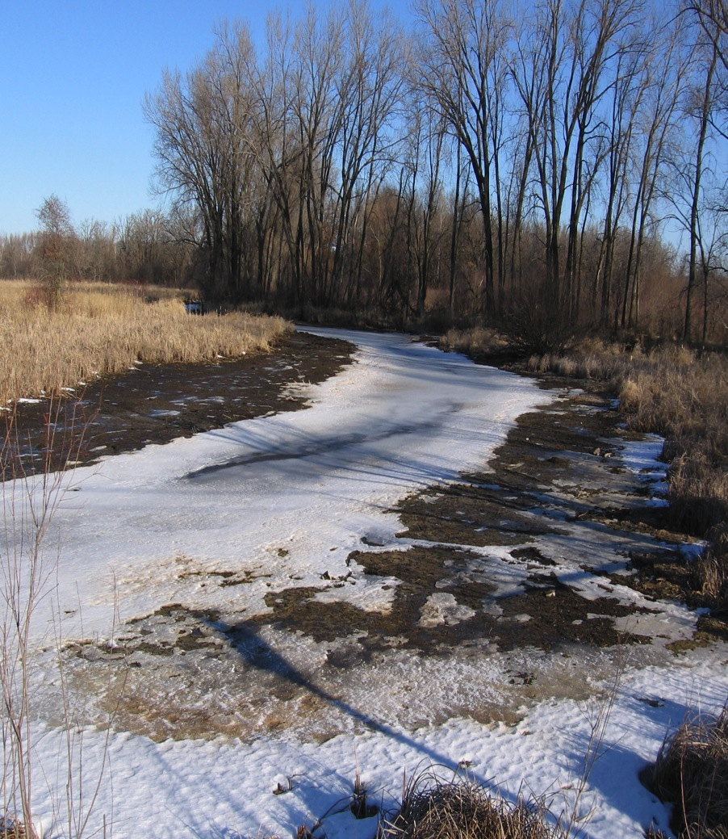
In the Winter, under the 1979 Lake Orders
Lake Mendota’s level is lowered so much that both flora and fauna are threatened.
This unnatural drawdown is done only to create flood capacity for the
Spring thaw flood risk, which in turn is caused by the unnaturally high Summer target levels of the 1979 Orders.
PHOTO: Six Mile Creek north of M, water at 848.44,
20 FEB 2012, Si Widstrand

Slide 55
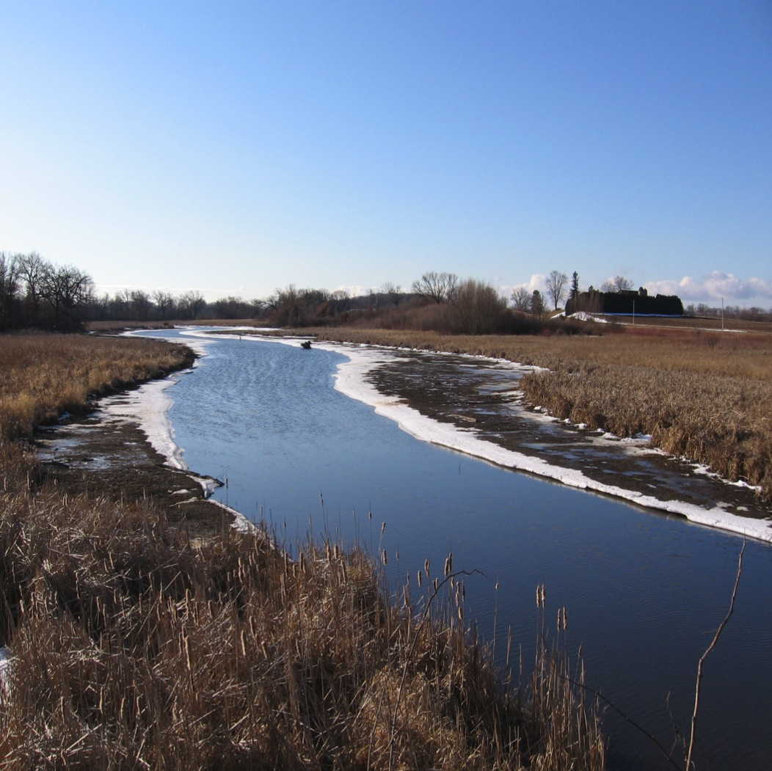
This radical seasonal swing in
Lake Mendota’s level prevents both submergent or shoreland vegetation from thriving.
PHOTO: Six Mile Creek, looking south from CTH M;
20 FEB 2012; Si Widstrand

Slide 56
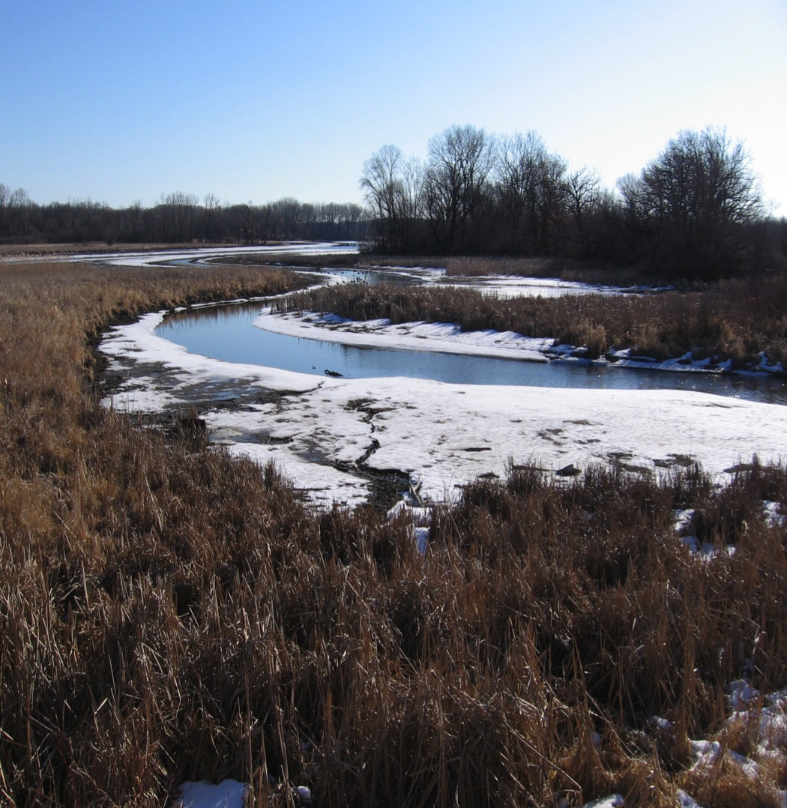
The result:
Barren shoreland mudflats in the winter, and barren stream bottoms in the summer.
PHOTO: Six Mile Creek, looking south from CTH M; 20 FEB 2012; Si Widstrand

Slide 57
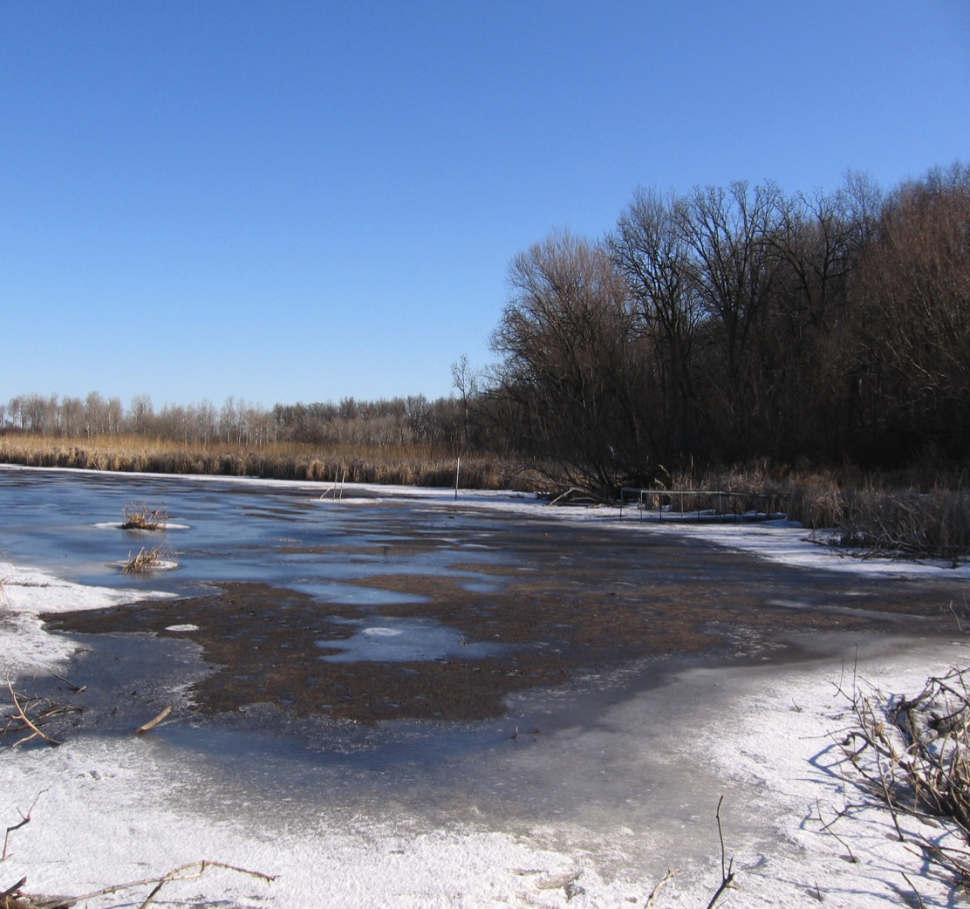
The extreme drop to the winter minimum undercuts a sizable public investment in shoreland vegetation restoration.
PHOTO: Yahara River, off North Unit of Cherokee Conservation Park (north end of “Cherokee Lake”)
20 FEB 2012; Si Widstrand

Slide 58
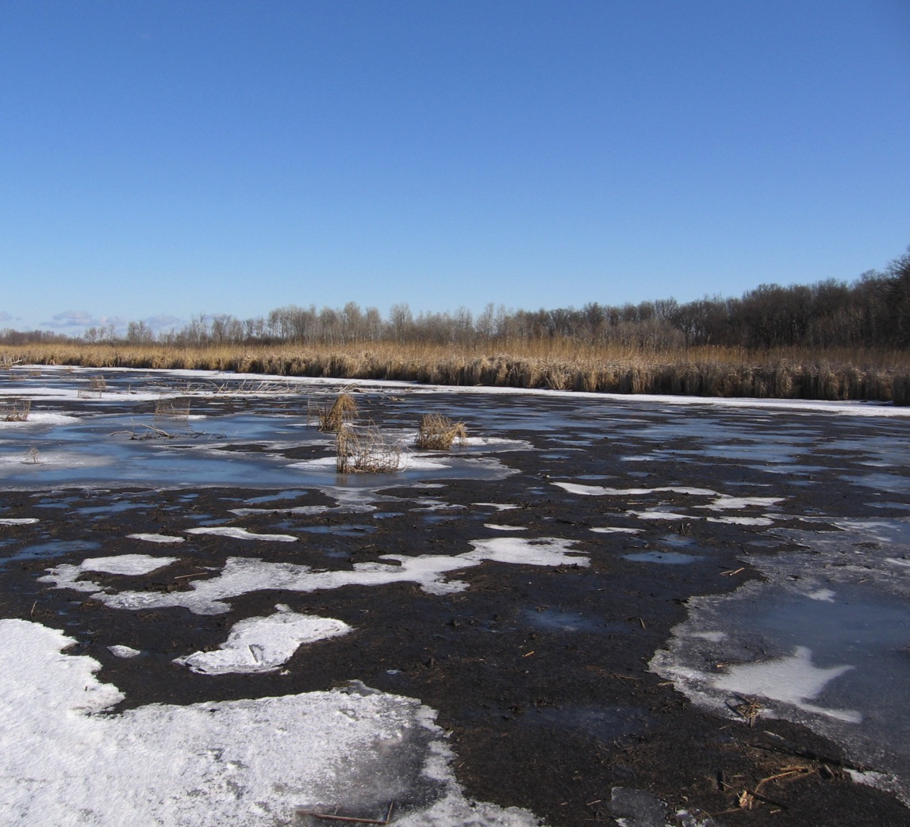
Winter mudflats in the Spring become a barren river bed.
PHOTO: Yahara River, off North Unit of Cherokee Conservation Park
(north end of “Cherokee Lake”); 20 FEB 2012; Si Widstrand

Slide 59
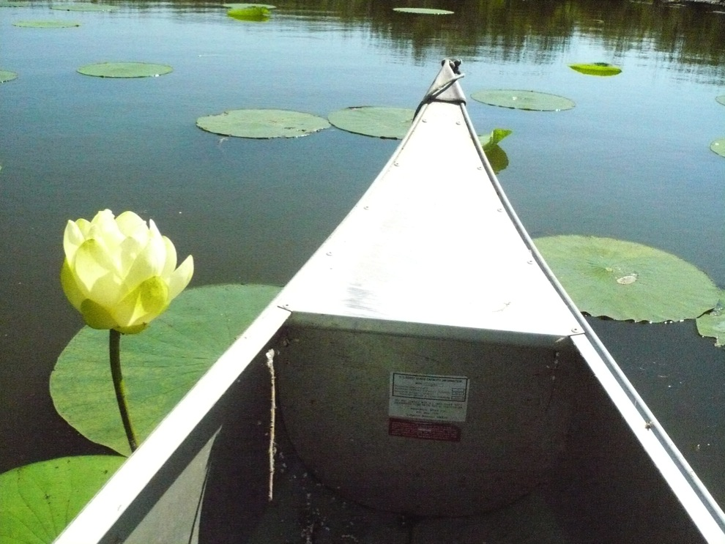
What are the benefits of lowering
Lake Mendota 6 inches?

Slide 60
The benefits of lowering Lake Mendota
6 inches are very compelling, across several categories:
ENVIRONMENTAL
WATER QUALITY
PUBLIC SAFETY & ECONOMIC
CULTURAL, RECREATION, & TOURISM

Slide 61
ENVIRONMENTAL BENEFITS
More and better habitat, by protecting existing wetlands, while also allowing more success in efforts to restore shore area vegetation.
Healthier, more natural conditions for wildlife, including fish, amphibians, shellfish, and birds or other flying critters.

Slide 62
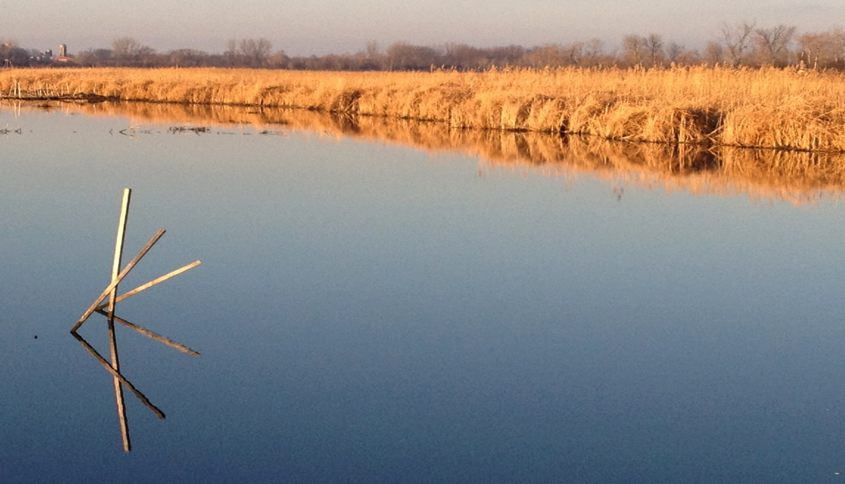
Our large investment in shore area restoration will have a better chance for success, giving even greater returns on frugal use of public funds.
PHOTO : Jon Becker

Slide 63
WATER QUALITY BENEFITS
Less sediment runoff
Reduced shoreline erosion
Less nutrient pollution

Slide 64
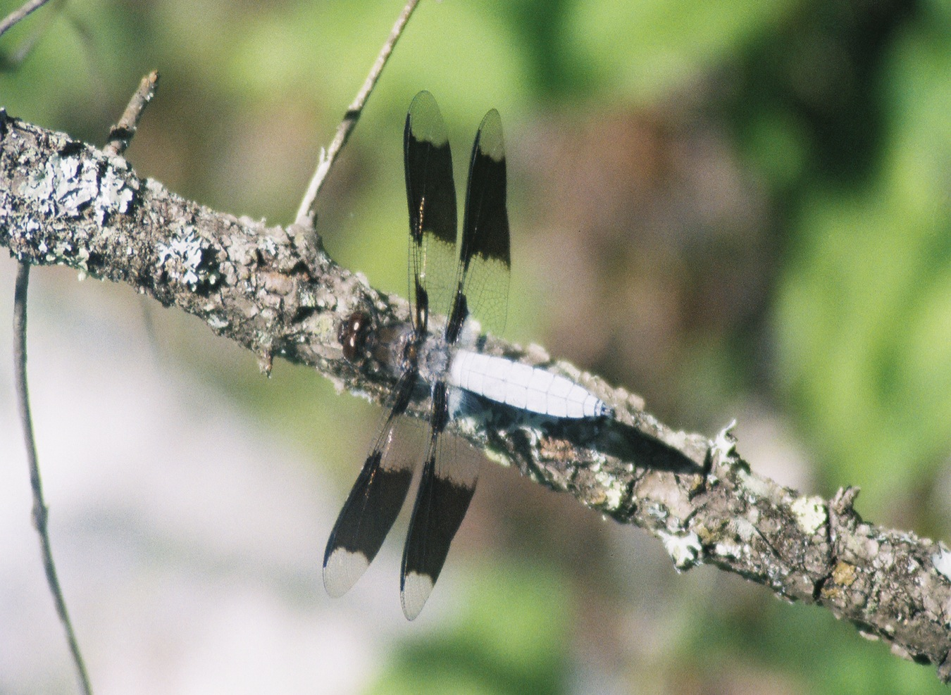

Slide 65
PUBLIC SAFETY &
ECONOMIC BENEFITS
Safer beaches for swimming
Increased capacity to handle emergency flooding, with less chance of over-topping Tenney dam, or breaching of adjacent shoreland, which would cause civic/private infrastructure damage and sewer problems

Slide 66
MORE PUBLIC SAFETY &
ECONOMIC BENEFITS
In 2008, Dane County suffered more than $68 million in damages from storm or climate-change related flooding.
In an emergency effort to prevent sanitary sewer backflows and uncontrolled sewage overflows into lakes and streams,
over a million gallons of sewage being dumped in a
high quality sedge meadow of Cherokee Marsh.
This area of the Marsh is being restored,
thanks to a considerable public investment of over $1 million.
A promised report on damage caused by the sewage
has not yet been delivered.
Many Isthmus residents and businesses were not so fortunate in 2008.
Storm sewers backed up, and their basements were damaged
by very high groundwater.

Slide 67
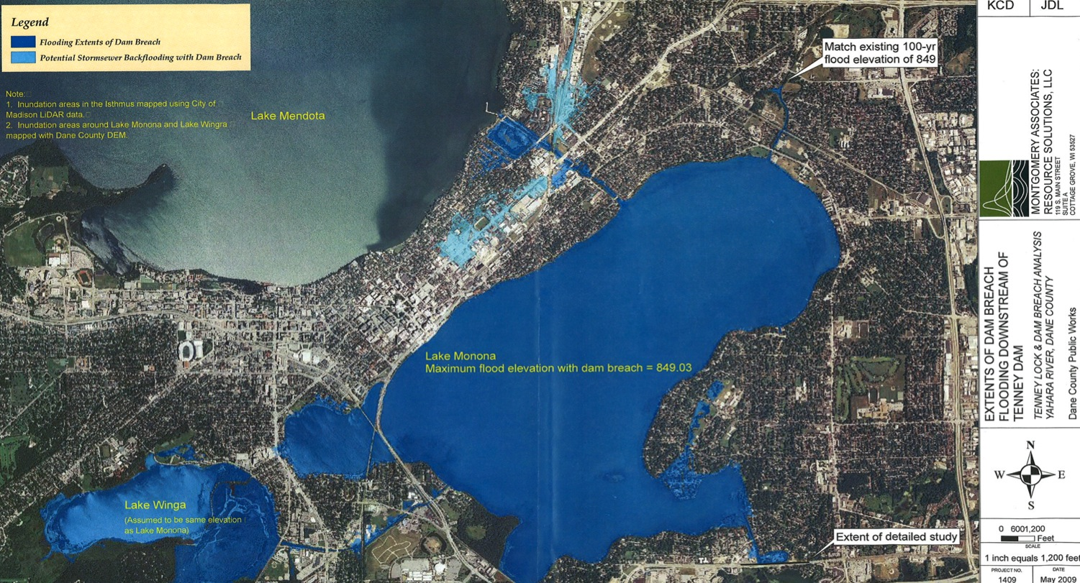
After nearly being overtopped by waves in 2000, the earthen dam along Tenney Beach was raised 2 feet.
When water levels are high, waves and wind can push water higher on the dam, or back through storm sewers.
This map from a 2009 study shows the potential impacts of the 100-year flood under different scenarios

Slide 68
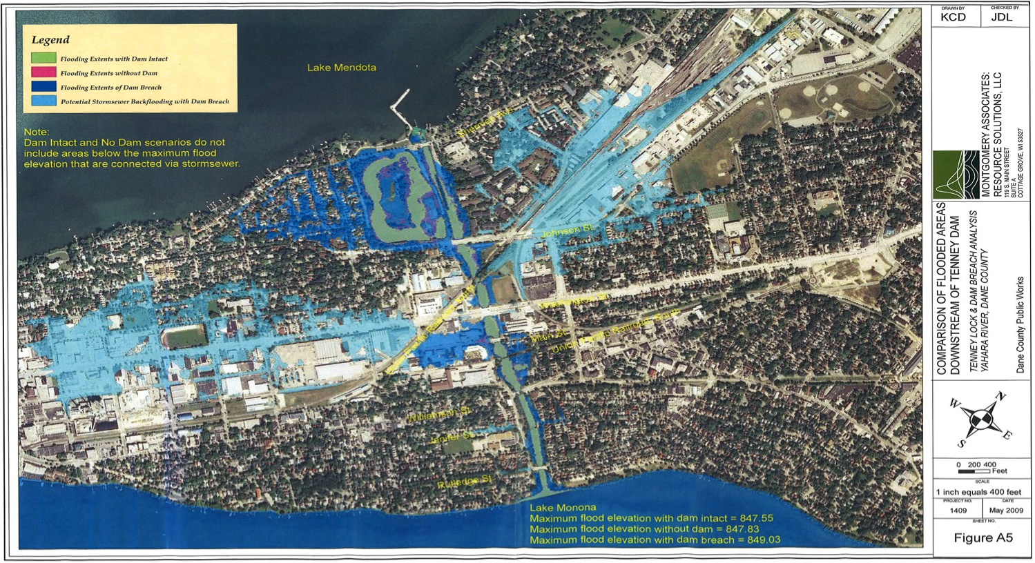
The dam was recently found structurally sound by engineers, so a breach is unlikely.
If breached, there’d be damage near Tenney Park and the Yahara channel, but also further away, due to backflooding.
FLOODING EXTENTS:
Green = w/dam intact Magenta = w/o dam Dark blue = w/dam breach
Light blue = Potential storm sewer backflooding w/breach.
This map from a 2009 study shows the potential impacts of the 100-year flood under different scenarios

Slide 69
TOURISM, CULTURAL & RECREATION BENEFITS
$2-3 billion is spent annually within Dane County, second in WI only to Milwaukee County
A more scenic and beautiful lake.
A more diverse habitat, including increased shoreline vegetation, creating better birding, and other outdoors observational activities.
A more interesting experience of Lake Mendota for paddlers and nearby hikers alike.
A more resilient, sustainable fishery.
Less damage to piers from wind and waves.

Slide 70
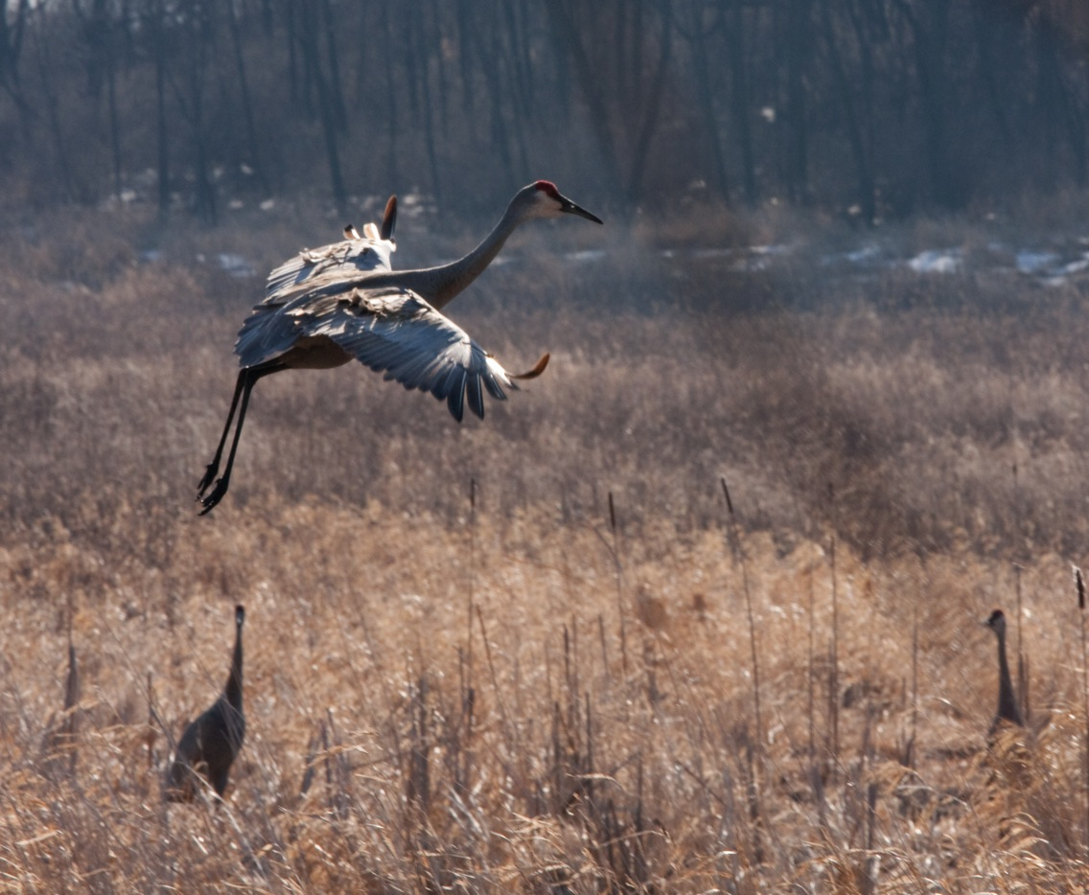
PHOTO CREDIT: Mario Quintana

Slide 71
Concerns?
A 6-inch drop would cause:
No negative impact on civic infrastructure, such as water intakes or stormwater outlets (S. Josheff, WDNR) or on management of downstream lakes under WDNR 1979 Lake Orders. (J. Balousek/K. Connors, Dane County)
No significant impact on shoreline location or appearance, though some areas may benefit from restoration of native plants.

Slide 72
Concerns?
A 6-inch drop could cause:
Localized impact on large boat navigation to harbors or marinas that have always required dredging (businesses may want to dredge again sooner, or to adjust any large boat-related aspects of their business plans).
Localized increases of some invasive plants.

Slide 73
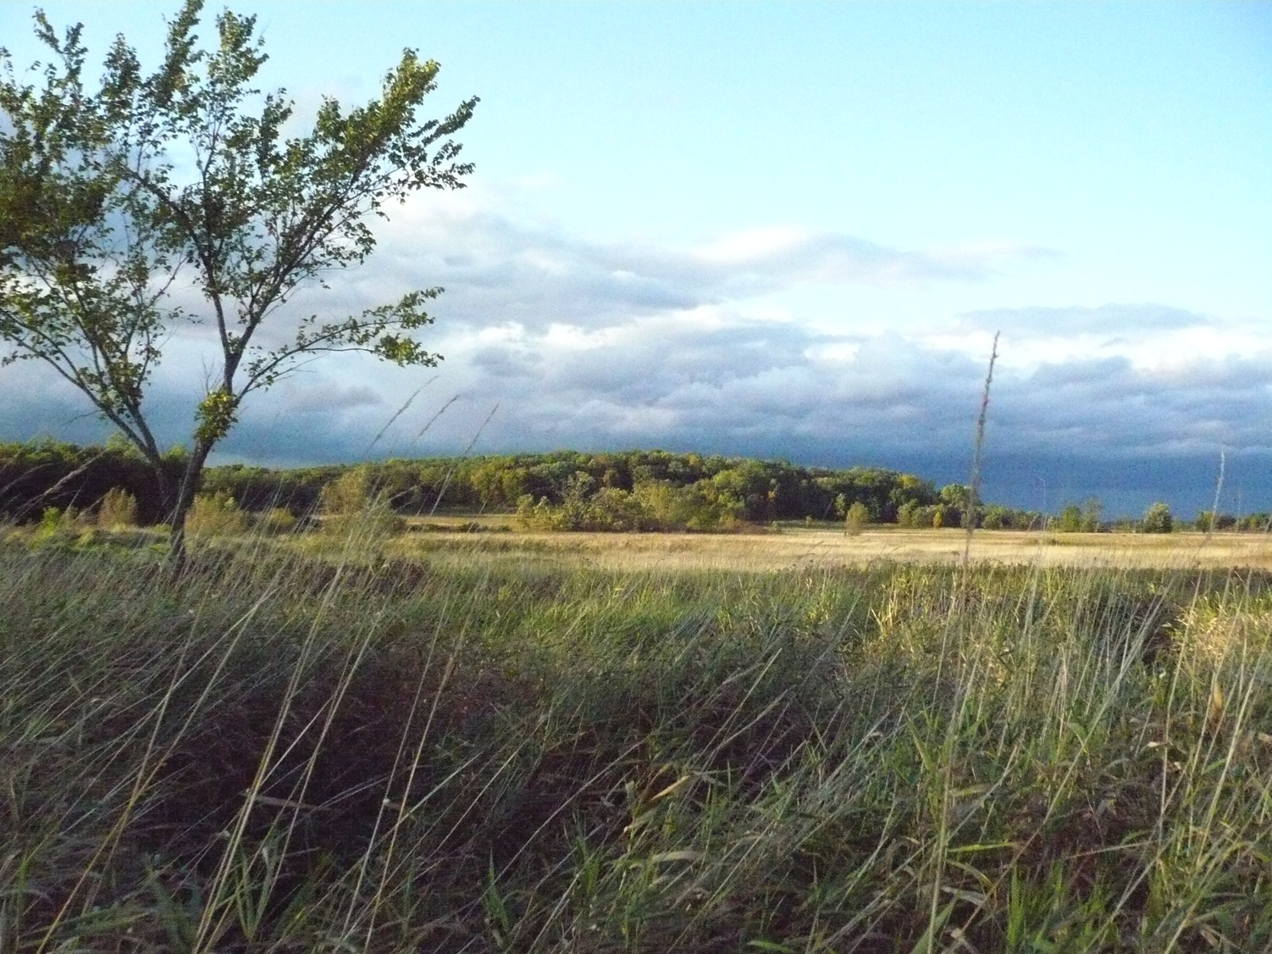
Cherokee Marsh North Unit
PHOTO CREDIT: Jon Becker

Slide 74
Toward a Natural Lake Mendota
PHASE 2: RESTORATION FOR A MORE NATURAL LAKE
Lower Lake Mendota to its natural level

Slide 75
After lowering Lake Mendota 6 inches, we can further enhance our lake for future generations!
How?
By further lowering summer target levels
in 2 inch increments annually
(with an ecologically correlated winter target level)
until Lake Mendota’s natural level is reached.

Slide 76

Sandhill Cranes in Upper Yahara River, Near Cherokee Marsh North Unit
PHOTO CREDIT: Mario Quintana

Slide 77
A natural Lake Mendota would be just a little higher than Lake Monona.
Lowering Lake Mendota 58 inches
(total, i.e., including the first drop of 6 inches)
would still leave an inch of head at Tenney Park dam.
That may be enough for successful management–
even under the current (1979) WDNR Lake Orders–
downstream, where the other three lakes are already usually managed at natural levels.
J. Balousek/K. Connors, Dane County

Slide 78
Yep, you read that right.
In the summertime, Lake Mendota is still being managed at about 5 feet higher than its natural level, even though there’s not been any need to power a mill for quite some time.
This managed level is unnatural and it’s killing Lake Mendota’s vital shoreline vegetation, marshes, and wetlands.
That’s unjustifiable, and undoes restoration efforts.
But we’ve gotten used to how it looks and functions.

Slide 79
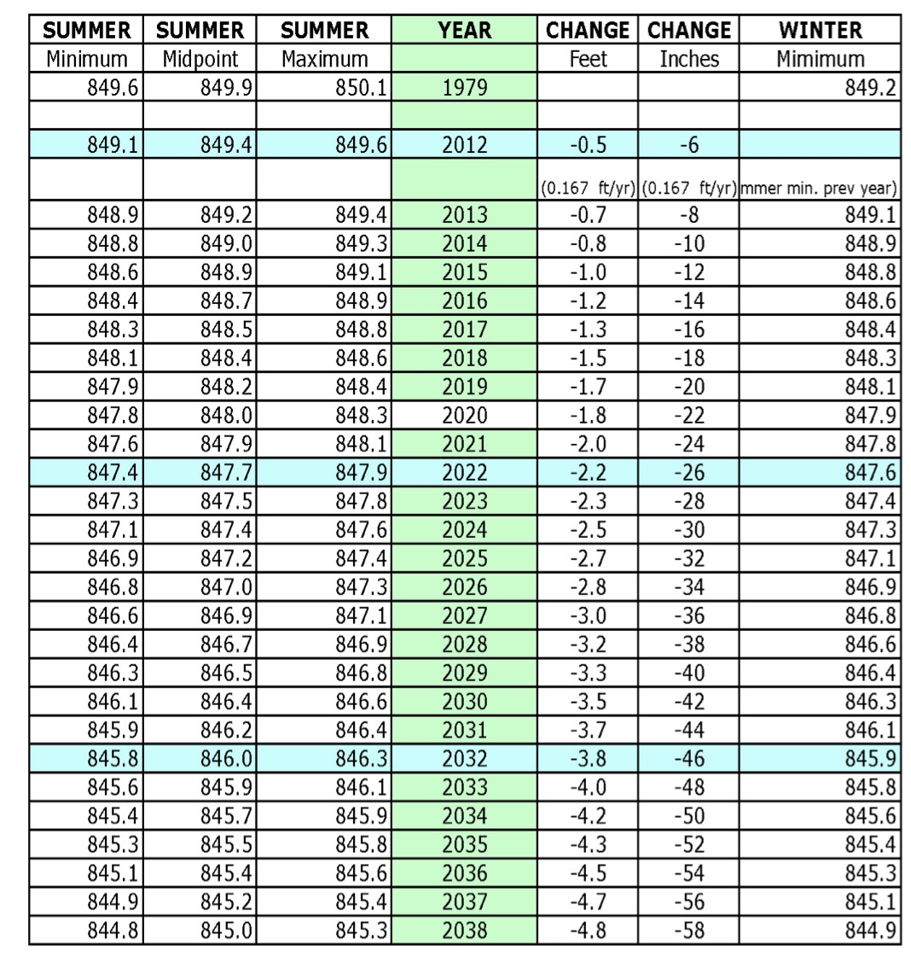
How Lake Mendota target levels would change,
2012-2038, if carefully lowered
2 in/yr.

Slide 80
Benefits
All the enormous environmental benefits of restoring at least a square mile of wetlands and native shoreline vegetation.
Reduced damage to civic/private infrastructure.
More diverse recreation opportunities.
Enhanced public safety.
Recovery of drowned Native American mounds, and historically documented white sand beaches.

Slide 81

Could native shellfish once again become abundant?
(After the Civil War, for several years there was a thriving market for freshwater pearls from the Rock River.
Shellfish found in channel near School Road landing on Yahara River, 5 February 2012 .
PHOTO CREDIT: Jon Becker

Slide 82
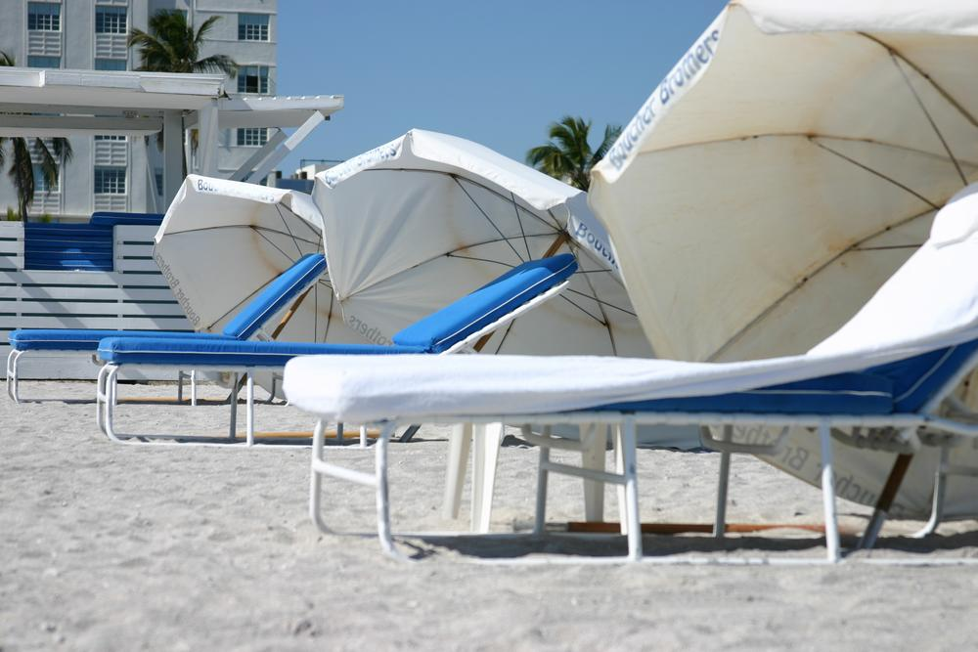
Could we enjoy Caribbean quality white sand beaches at Tenney Park?

Slide 83
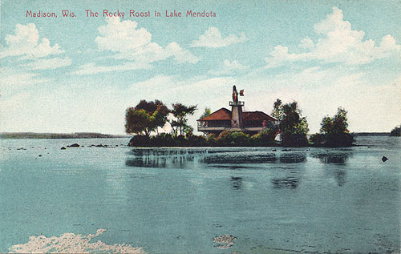
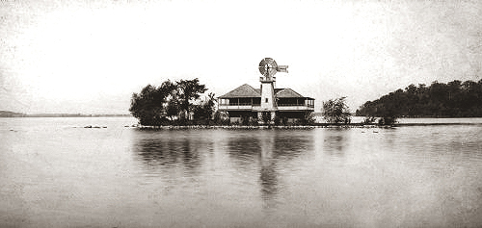
Should we rebuild Frank Lloyd Wright’s Rocky Roost?

Slide 84
CONCERNS?
Actually, there are not very many.
As the natural shoreline re-emerges, invasive plant species will need to be controlled. Research of Lake Michigan’s recently lower level indicates that natural fluctuations in lake levels provide a competitive advantage for native plants over invasives. (J. Zedler, UW-Madison)
To prevent drying of adjacent wetlands, some artificial ditches may need to be blocked or filled, as the lake’s natural hydrology is restored. (Q. Carpenter, UW)
The submergent aquatic vegetation will need sufficient time to “migrate” outward, along with the shoreline.

Slide 85
CONCERNS?
As the normal high water mark changes, continued public interest in the exposed shoreland will need to be secured.
Public ownership of the recovered shoreland would secure at least a bit of the profound benefits that would have been ours, if only John Nolen’s recommendation to avoid development on the shores of all the Yahara lakes had actually been implemented.
The recovered shoreland could, for example, provide room for public trails and walkways, such as the proposed boardwalk from James Madison Park to the Union Terrace.

Slide 86
OTHER CONCERNS?
The length or height of some piers may need to be adjusted.
Adjustments may be necessary for boat launches and public access points as levels decline.
Some harbors or marinas that are oriented to large boat owners may need to transition to a new customer base, over the course of 2-3 decades.
Channel dredging may be needed during this transition period, although as the lake is lowered, gravity and water movement will do much of this work, just as it does under present conditions.

Slide 87

These concerns are easily outweighed by the many benefits of a natural
Lake Mendota.
It may comfort those who are fearful of change to remember that the lowering can always be paused temporarily, or even reversed, if ecological conditions warrant.
CREDIT: Jon Becker

Slide 88
What will a more natural Lake Mendota, ~58 inches lower, look like?
Mostly, not much different at all.
White sand beaches may be recovered, including those near Tenney Park.
In a few areas, it may be possible to restore up to 200 feet of marsh or wetlands that have been drowned.
At the northern estuary and near Picnic Point, it will be possible to restore much larger former marshes and wetlands, across areas extending 600 feet or more from the current shoreline.

Slide 89

Red line = Current shoreline
Green line = Natural shoreline (ca. 5 ft lower)
Yellow highlighted area = Recovered marsh or sandy beach
WDNR map, modified by Jon Becker

Slide 90

Picnic Point area dark blue contour line
= natural shoreline, after lake is lowered about 5 ft
Courtesy Dane Co.
Planning Dept.

Slide 91

UW Campus to Edgewater area dark blue contour line
= natural shoreline, after lake is lowered about 5 ft
Courtesy Dane Co.
Planning Dept.

Slide 92

Tenney Park pier, northward to
Warner Park lagoons dark blue contour line
= natural shoreline, after lake is lowered about 5 ft
Courtesy Dane Co. Planning Dept.

Slide 93

Governors Island area dark blue contour line
= natural shoreline, after lake is lowered about 5 ft
Courtesy Dane Co.
Planning Dept.

Slide 94

Yahara
Estuary dark blue contour line
= natural shoreline, after lake is lowered about 5 ft
Courtesy Dane Co. Planning Dept.
Courtesy Dane Co.
Planning Dept.

Slide 95
Toward a Natural Lake Mendota
PHASE 1: STOPPING THE DAMAGE
No later than MAR 2013, lower the 1979 Lake Order summer targets by 6”. Adjust the winter 2013-14 target to equal the new summer minimum target.
PHASE 2: RESTORATION FOR A MORE NATURAL LAKE
By JAN 2014, complete all studies and public participation necessary to begin further lowering the summer targets 2” per year, starting in summer 2014, until the natural level is achieved (~58” total). Annually adjust the Winter target to match the preceding summer’s minimum target.
CONCURRENT LAND USE MANAGEMENT
Require that all future development in the Lake Mendota sub-watershed recreates natural hydrological conditions, while also retrofitting existing development insofar as possible toward this standard, to assure that Lake Mendota is not utilized as a detention facility for unnatural stormwater runoff.

Slide 96
How Natural Lakes Look

Slide 97

Let’s paddle together back to the future, creating a gift for generations to come!
PHOTO: Jan Axelson

Slide 98

Capital Region Advocacy Network for Environmental Sustainability CRANES
PHOTO CREDIT: Mario Quintana

